Slide 1


To Do List
Presentation On
By Group-10

Slide 2
Submitted To Mrs. Atia Binti Aziz Adjunct Lecturer Dept. of CSE, IIUC
Submitted By
Tehsim Fariha (C193207)
Nujhat Tabassum(C193203)
Sadiya Afrin Priya (C193228)

Slide 3
Introduction
It’s a list of tasks We need to complete or things that what we want to do. Traditionally, they’re written on a piece of paper or post it notes and act as a memory aid.
As technology has evolved, we have been able to create a to do lists using software for example: excel spreadsheets, to do list apps, Microsoft to do and google to do list etc.

Slide 4
Features
It is user friendly.
Console based input output system
Simple and Easy for all user
Keep records of List items in File
Easy to maintain

Slide 5
Development Tools
Software used : Apache NetBeans IDE 15 , IntelliJ IDEA
Java as Programming Language
For storing data permanently, we have used file

Slide 6

Block Diagram
*Exit Program Menu
*Display List Menu
*Add List Menu
*Delete Item Menu
Menu
Process
Output

Slide 7
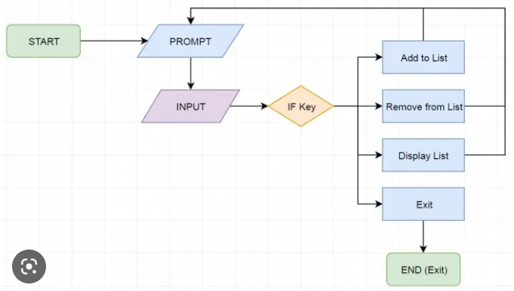
Flowchart

Slide 8
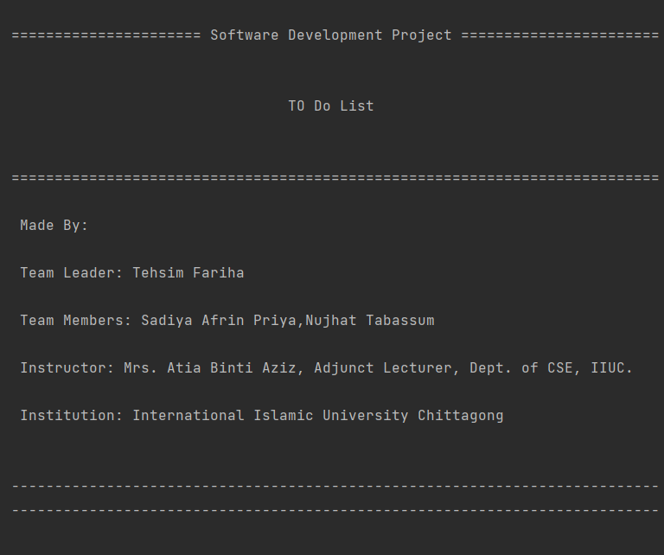
Output

Slide 9
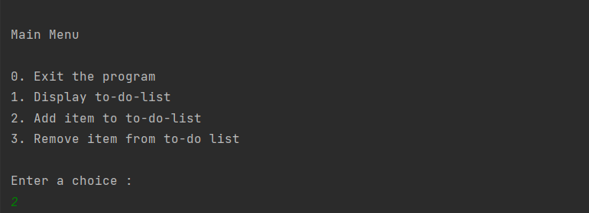

Choice Menu
Add item

Slide 10
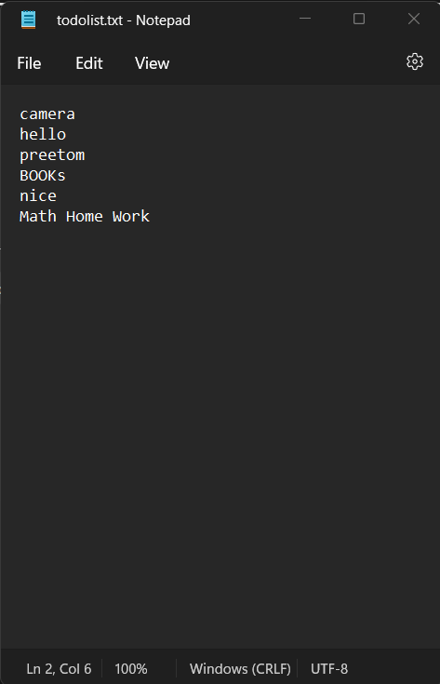
Item added in todolist.txt File

Slide 11
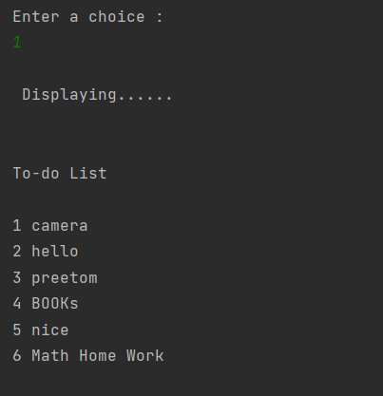
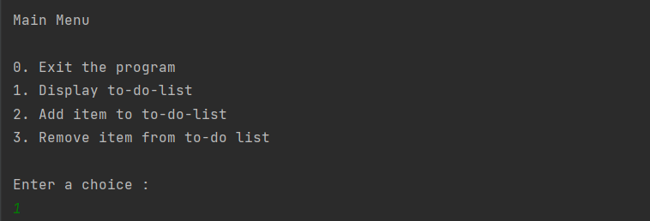
Displaying List
Choice Menu

Slide 12
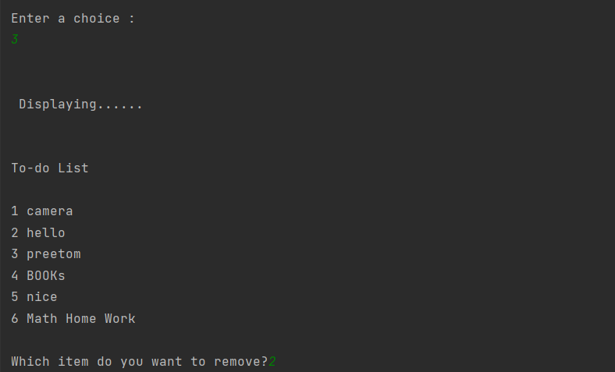
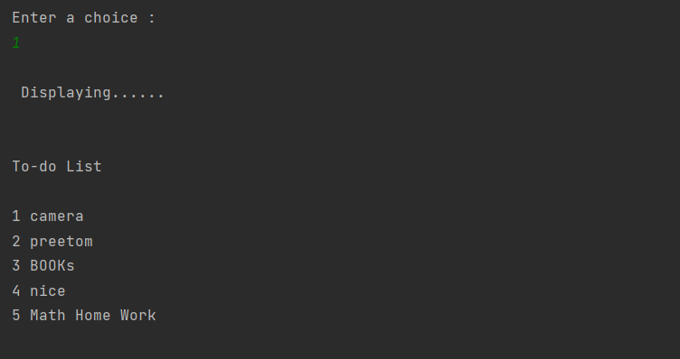
Remove item
After deleting item 2 from list

Slide 13
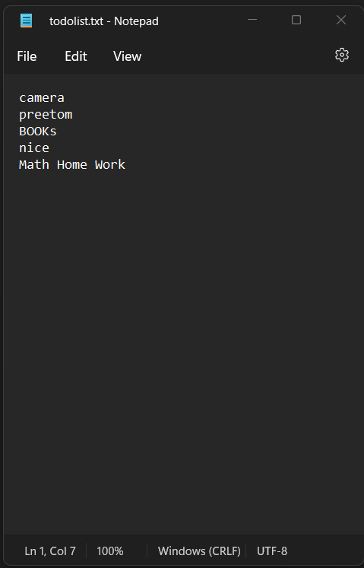
Item 2 deleted from file

Slide 14
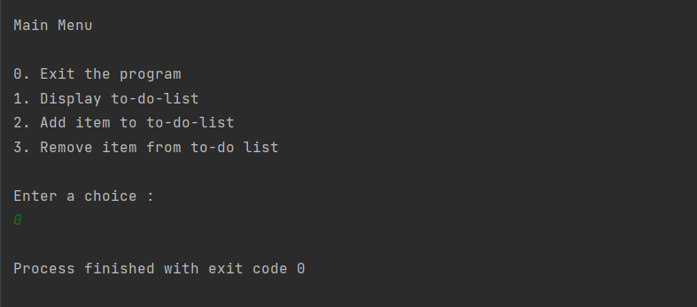
Exit the Program

Slide 15
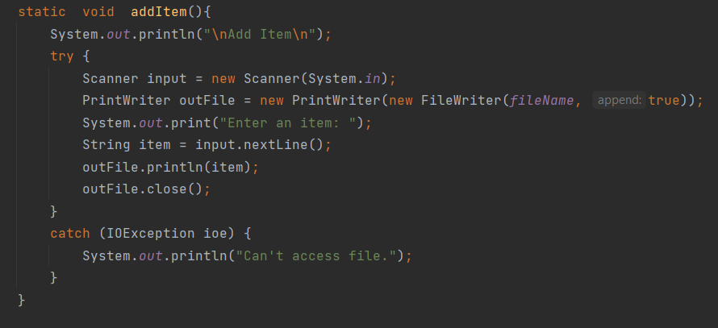
Error Handling

Slide 16
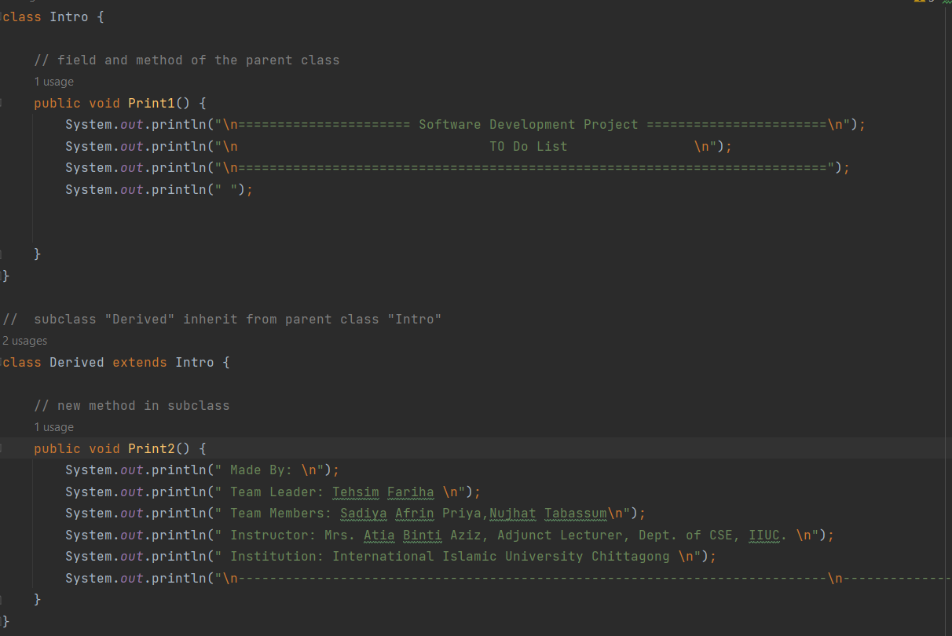
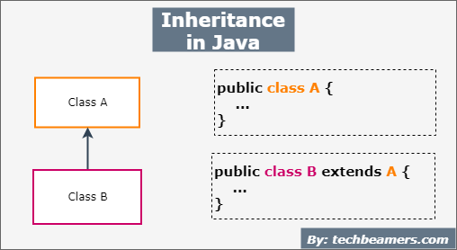
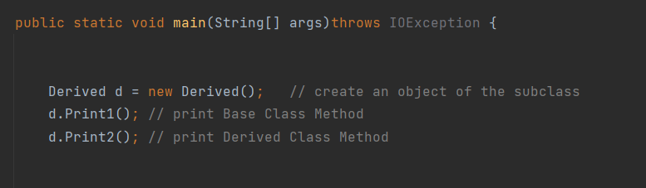
Object Oriented Programming

Slide 17
Limitation
Can’t delete the whole list at once
Don’t have search option

Slide 18
Future Scope
Application Based To-Do-List
Online Based To-Do-List
Deadlines for list items.
Review and revisit the list.
keep all list items organized.
Calendar view.

Slide 19
GitHub Link
https://github.com/Tehsim

Slide 20

Thank You

